Slide 1

Martingale Protocol

Slide 2
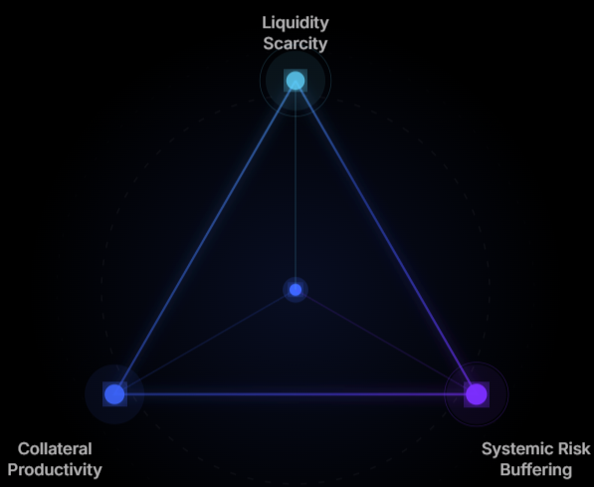
Overview
Martingale protocol is decentralized credit, which combines stablecoin and lending Markets.
Pledge underlying to borrow stable coins
Customized DeFi investment tools for users with different risk preferences

Slide 3
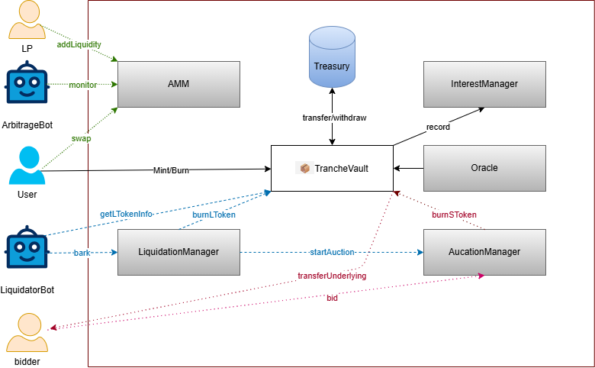
System Architecture

Slide 4
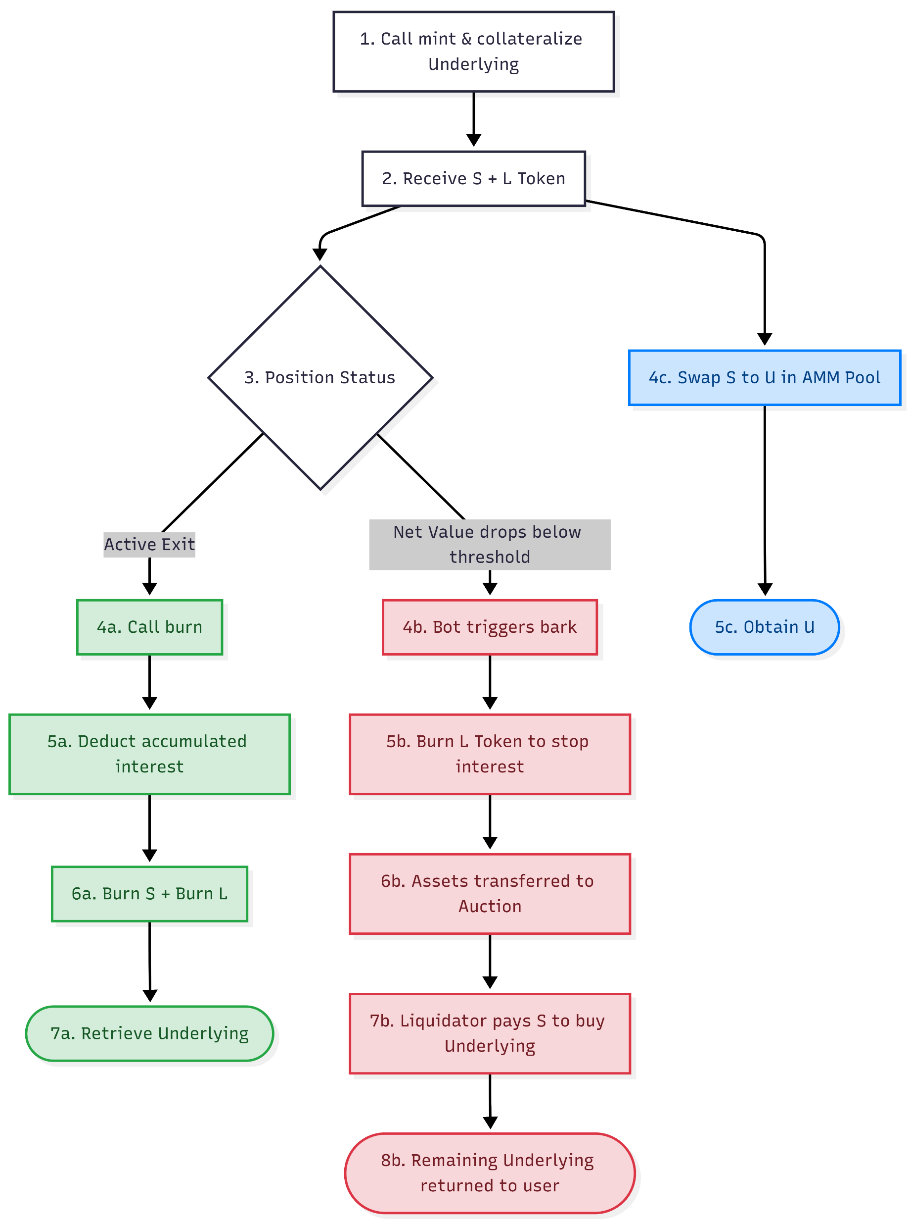
Life Cycle

Slide 5
Model Ⅰ——Mint/Burn
ERC20
Tokenized
Asset
Underlying
Asset
Mint/Burn
ERC1155
ERC20
L Token
S Token
AMM
(S+U)
U
Liquidation
Oracle
Protocol

Slide 6
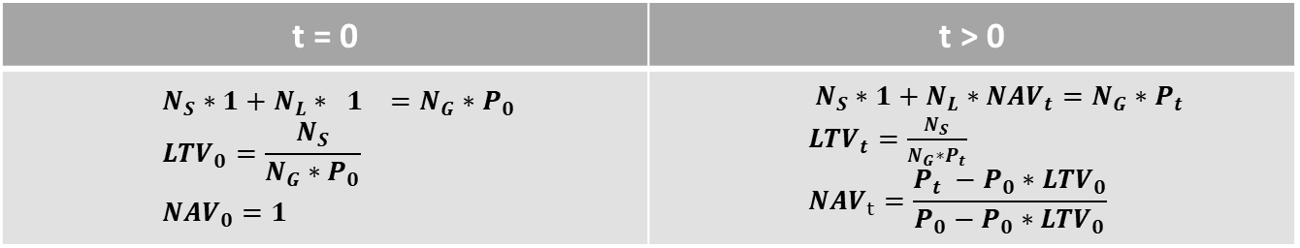

Model Ⅰ——Mint/Burn
Parameters：${LTV}_{max}=75\%$, $Liquidation= {LTV}_{max}+x\%$
Mint：Stake $N_{G}$ Underlying ➔ Mint $N_{S}$ stable token + $N_{L}$ leverage token
Burn： Users can burn minted assets in any proportion to redeem the underlying assets.
t = 0 | t > 0
$$N_{S}∗1+N_{L}∗ 1 =N_{G}∗P_{0}$$ $${LTV}_{0}=\frac{N_{S}}{N_{G}∗P_{0}}$$ ${NAV}_{0}=1$ | $N_{S}∗1+N_{L}∗{NAV}_{t}=N_{G}∗P_{t}$ ${LTV}_{t}=\frac{N_{S}}{N_{G}∗P_{t}}$ $${NAV}_{t}=\frac{P_{t} −P_{0}∗{LTV}_{0}}{P_{0}−P_{0}∗{LTV}_{0}}$$

Slide 7
Model Ⅱ——Interest Rate Model
Protocol
User
Tokenized Asset←→ S & L
TrancheVault
Underlying Asset
Tokenized Asset
U ←→ S
AMM(U+S)
Underlying token issuer
First lending: Lend out physical gold to receive tokens and earn interest.
Second lending: Pledge tokens to borrow USDT and pay interest.

Slide 8
Model Ⅱ——Interest Rate Model
Collateralize Tokenized Asset→Borrow U
Users pay interest to protocol
Model:
Gross Borrow Rate = Base Rate + Utilization Factor + Collateral Risk Premium
Base Rate: Lending interest rate for USD (U)
Utilization Factor: The fewer U in the AMM, the higher the factor
Collateral Risk Premium: Risk premium of the underlying asset
Practical:
Interest is accrued on a per‑second basis and reflected in the net value of L tokens.
Upon burning, the deduction is made once in the form of the underlying asset

Slide 9
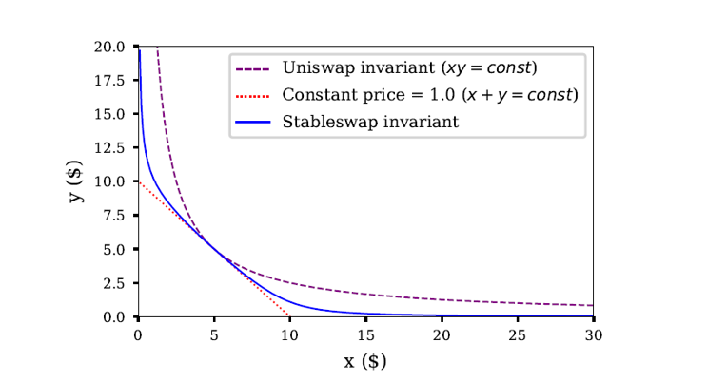
Model Ⅲ——AMM
AMM:
S token + U
Stableswap invariant
Arbitrage:
Use an arbitrage program to monitor AMM deviations.

Slide 10
Model Ⅳ——Oracle
Third-party oracles
Chainlink
Pyth Network
RedStone
Core features:
Delayed price updates
Multi-source aggregation
Multi-signature voting mechanism
Emergency halt
Price change threshold

Slide 11
Model Ⅴ——Liquidation
Keeper
User L token
①Bark
②
②
Remaining
Tokenized Asset
② reward
Burn L token
Burn S token
reset
Penalty
Custodian
Auction
Bidder
④
③Buy tokenized Asset
S token
③Pay S token
NOTE: The liquidation model determines the optimal liquidation boundary based on system parameters for users.

Slide 12
Mechanism
On-chain
Access Control / Multi-sig
Whitelist
Proxy Pattern
……
Off-chain
Liquidation bots
Arbitrage bots
Maintenances bots
……

Slide 13
Website
Martingale: https://martingaleco.com
App Demo: https://test-al2.pages.dev/app
Documentation: https://test2026.gitbook.io/test-tranche_protocol/fMFG0viXW9hbW0MeCbeh/

